Slide 1
School of Information
Technology
Project Management: Cost

Slide 2
Learning Objectives
Understand the importance of project cost management
Explain basic project cost management principles, concepts, and terms
Discuss different types of cost estimates and methods for preparing them

Slide 3
Learning Objectives
Understand the processes involved in cost budgeting and preparing a cost estimate and budget for an information technology project
Describe how project management software can assist in project cost management

Slide 4
The Importance of Project Cost Management
IT projects have a poor track record for meeting budget goals
The CHAOS studies found the average cost overrun (the additional percentage or dollar amount by which actual costs exceed estimates) ranged from 180% in 1994 to 56% in 2004; other studies found overruns to be between 33-34%

Slide 5
What is Cost and Project Cost Management?
Cost is a resource sacrificed or foregone to achieve a specific objective or something given up in exchange
    Costs are usually measured in monetary units
Project cost management includes the processes required to ensure that the project is completed within an approved budget

Slide 6
Basic Principles of Cost Management
Most members of an executive board
better understand (and are more
interested in) financial terms than IT
terms, so IT project managers must
be able to communicate with them in
their own language

Slide 7
Basic Principles of Cost Management
  Profits are revenues minus expenditures
  Profit margin is the ratio of revenues to profits
  Life cycle costing considers the total cost of ownership, or development plus support costs, for a project
  Cash flow analysis determines the estimated annual costs and benefits for a project and the resulting annual cash flow

Slide 8
Basic Principles of Cost Management
Tangible costs or benefits are those that are easily identified
Intangible costs or benefits are those that are not so easily identified
Direct costs are costs that can be directly related to producing the products and services of the project
Indirect costs are costs that are not directly related to the products or services of the project, but are indirectly related to performing the project

Slide 9
What Went Right?
Many organizations use IT to reduce operational costs
For example: technology has decreased the costs associated with processing an ATM transaction:
    In 1968, the average cost was $5
    In 1978, the cost went down to $1.50
    In 1988, the cost was just a nickel
    In 1998, it only cost a penny
    In 2008, the cost was just half a penny!

Slide 10
Project Cost Management Processes
Estimating costs: developing an approximation or estimate of the resources needed to complete a project. A major output is the cost estimates of individual work items (packages).
Determining the budget: determining the overall cost, based on the estimates, to establish a baseline for measuring performance.
Controlling costs: controlling changes to the project budget

Slide 11
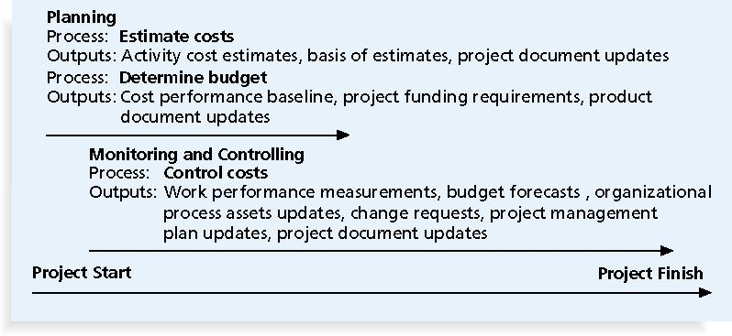
Project Cost Management Summary

Slide 12
Cost Management Plan
A cost management plan is a document that describes how the organization will manage cost variances on the project
A large percentage of total project costs are often labour costs, so project managers must develop and track estimates for labour

Slide 13
1. Estimating Costs
Project managers must take cost estimates seriously if they want to complete projects within budget constraints
It’s important to know the types of cost estimates, how to prepare cost estimates, and typical problems associated with IT cost estimates

Slide 14
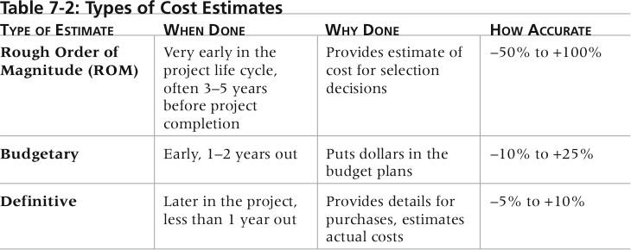
Types of Cost Estimates

Slide 15
Resource Management
This means deciding what resources are required:
  Has the organization done something similar before?
  Does this project include anything unique?
  Are there any particularly difficult or risky tasks?
  Are there any tasks for which there are limited resources?
  Does the organization need to procure new equipment, software, hardware or people?
The greatest cost is always human resources

Slide 16
Basic Cost Estimation Tools and Techniques
Analogous or top-down estimates: use the actual cost of a previous, similar project as the basis for estimating the cost of the current project
  Bottom-up estimates: involve estimating individual work items or activities and summing them to get a project total
  Parametric modeling uses project characteristics (parameters) in a mathematical model to estimate project costs

Slide 17
Typical Problems with IT Cost Estimates
Estimates are done too quickly
Lack of estimating experience
Human beings are biased toward under-estimation

Slide 18
Cost Estimate
Before creating an estimate, know what it will be used for, gather as much information as possible, and clarify the ground rules and assumptions for the estimate
If possible, estimate costs by major Work Breakdown Structure categories
Create a cost model to make it easy to make changes to and document the estimate

Slide 19
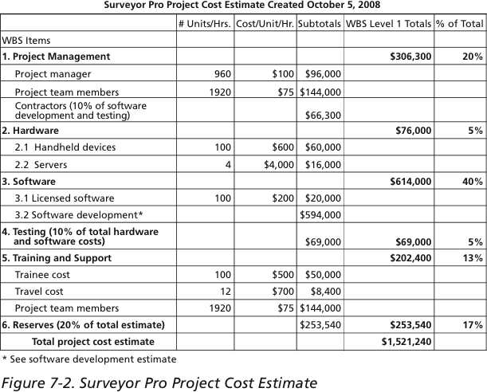
Sample Project Cost Estimate

Slide 20
2. Determining the Budget
Cost budgeting involves allocating the project cost estimate to individual work items (packages) over time
The WBS is a required input to the cost budgeting process since it defines the work items (packages)

Slide 21
3. Controlling Costs
Project cost control includes:
    Monitoring cost performance
    Ensuring that only appropriate project changes are included in a revised cost baseline
    Informing project stakeholders of authorized changes to the project that will affect costs

Slide 22
Schedule Performance Index (SPI)
The Schedule Performance Index (SPI) shows how you are progressing compared to the planned project schedule.
According to the PMBOK Guide, “The Schedule Performance Index (SPI) is a measure of schedule efficiency, expressed as the ratio of earned value to planned value.”
You can conclude that:
  You have completed more work than planned if the SPI is greater than one; the project is ahead of schedule.
  If you have completed less work than planned work if the SPI is less than one. The project is behind schedule.
  The completed work is equal to the planned work if the SPI is equal to one; the project is on schedule.

Slide 23
Best Practice
A global survey released by Borland Software in 2006 suggests that many organizations are still at a low level of maturity in terms of how they define project goals, allocate resources, and measure overall success of their information technology portfolios

Slide 24
Best Practice
Some results include the following:
    Only 22% of survey respondents reported that their organization either effectively or very effectively used a project plan for managing projects
    Only 17% had either rigorous or very rigorous processes for project plans, which included developing a baseline and estimating schedule, cost, and business impact of projects
    Only 20% agreed their organizations monitored portfolio progress and coordinated across inter-dependent projects

Slide 25
Using Software to Assist in Cost Management
Spreadsheets are a common tool for resource planning, cost estimating, cost budgeting, and cost control
Many companies use more sophisticated and centralized financial applications software for cost information
Project management software has many cost-related features, especially enterprise PM software
Portfolio management software can help reduce costs

Slide 26
Summary
Project cost management is a traditionally weak area of IT projects, and project managers must work to improve their ability to deliver projects within approved budgets
Main processes include:
    Estimate costs
    Determine the budget
    Control costs

